Slide 1
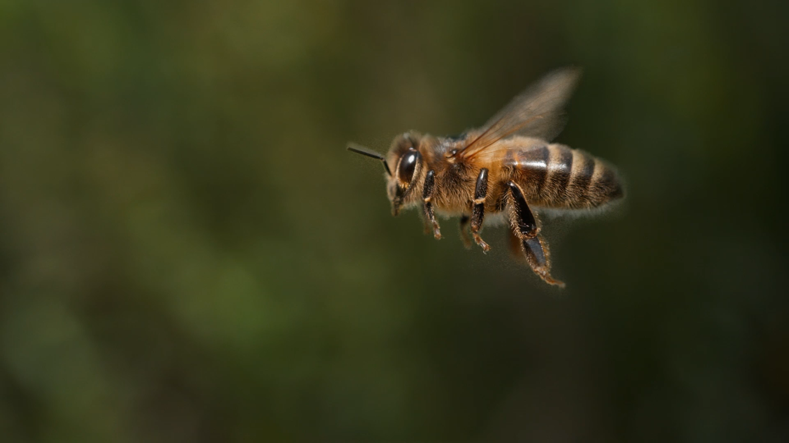
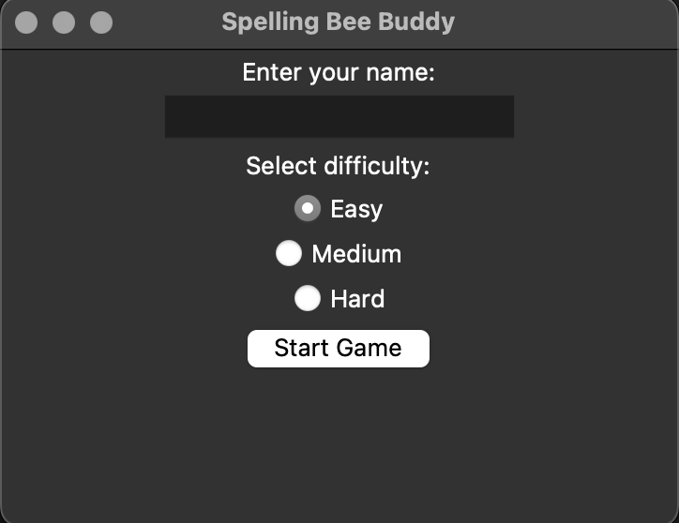
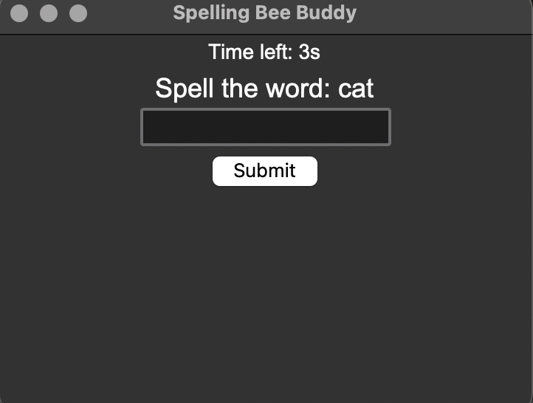
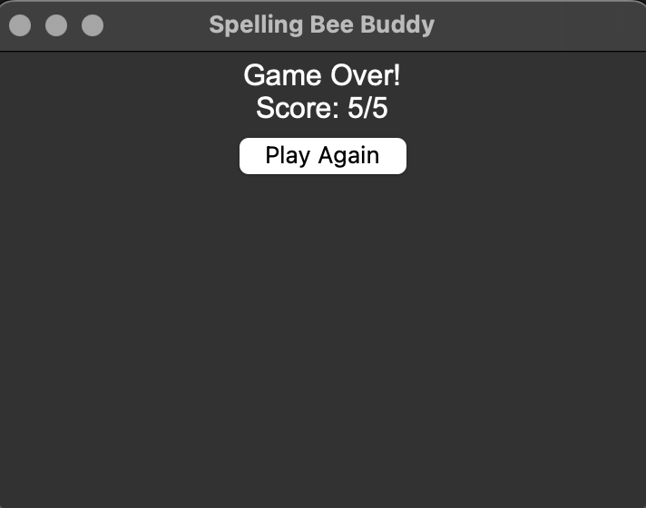
Spelling Bee Buddy
By: Moko Djane
"Helping kids spell better with voice and play."
GitHub Repo URL: https://github.com/ksu-is/spelling-bee-buddy

